Slide 1
As a PMDOS® attendee, you have access to 5 *FREE* licenses to task-management software for you and your team, for a whole year…sweet!
Now, want to see how to use to improve your team’s productivity by 50% or more, guaranteed?
Fortezza Consulting—the first Founding Sponsor of PMDOS(!)—can show you how!
(drum roll to the next slide, please ☺)

Slide 2
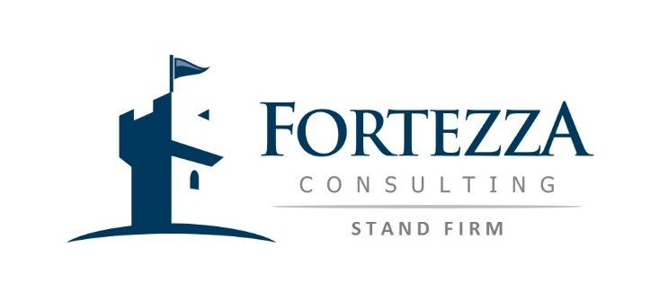
You’ll get:
Initial training on flow-maximizing concepts
Task-board setup and usage training
Coaching on effective usage
Guarantee of a 50% improvement in productivity within 1 month, or we’ll keep at it at no additional cost until 50% is achieved!
For any team, at any current performance level, whether Agile or Traditional, project or operations
All for less than $10K—half upfront, and the other half only after your 50% improvement is attained. Just contact Mike Hannan at 301.520.0899 or Mike@FortezzaConsulting.com for details.

Slide 3
Just a few customer testimonials on this approach—all are willing to serve as enthusiastic references:
“Within a month, Fortezza helped us double productivity across the entire team, and we have lots more ideas for how we might double it again!”
“Some of my senior top performers are getting a week’s worth of work done in less than a day…incredible!”
“What you have done to help change things around here is amazing….Thanks for your great work.”

